Slide 1
ITALYININDIA
Webinar
“Italian Institutions & Companies faced with the current health emergency”
15 April 2020

Slide 2
Where were we before Covid-19…
Business Conclave 28 February 2020
@ITANewDelhi
@italyinindia

Slide 3
Italy – India Partnership
Bilateral trade
2016 - 2019 → +18% (ISTAT)
Italian Exports to India to grew +20% between 2016-2019 (Istat)
GOAL → reach +30% in 2025
Investments
Important Indian investments in Italy (Mittal, Mahindra, Jindal)
Italian investments in India → €6.4Bn
Tourism
The average Indian tourist spends approx. $1800 and $2500 per week in Italy
@italyinindia

Slide 4
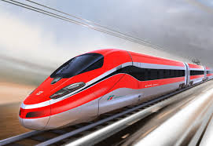
Italy – India Partnership 2020-2025 ∙ Sectors
Pursuing the “Granular approach” focused on 4 main sectors
Green and Circular Economy → Renewable energies and clean-tech
Infrastructure → Railways
Food processing
Make in India
Lifestyle
@italyinindia

Slide 5
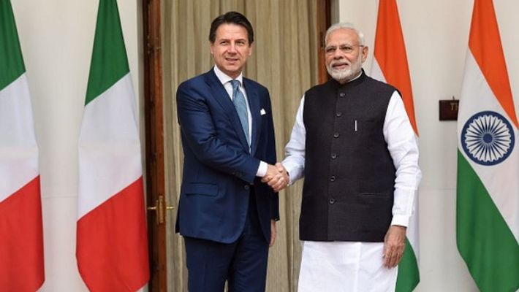
Italy – India Partnership 2020-2025. The objectives are the same but…postponed!
State Visit of PM Modi to Rome (originally
scheduled in May)
Comprehensive Business Delegation
led by the Minister of Foreign Affairs
(originally scheduled in October 2020)
Conclusion of MoUs in several fields (from double taxation to environment…)
@italyinindia

Slide 6
The Lockdown and its implications…
Closing of both public offices, commercial and industrial establishments with the exception of essential commodities.
Core domains of production activities allowed:
Pharmaceutical/Medical Equipment
Food
Measures to be adopted by operational productive plants:
Social distancing.
Regular sanitization.
20% to 25% capacity in single shift as a start (for big companies in electronic manufacturing, textiles, automobiles).
“Phase two” to be rolled-out district-wise based on the evolution of the contagion.
Suspension of all transport services air, rail, roadways with the exception of transportation for essential goods.
@italyinindia

Slide 7
Impact of the lockdown on the Indian Economy at Macro Level
- Projected GDP growth: 1.9% in 2020 (source IMF)
Government spending to grow at 15% in FY21 compared to 9.8% in FY20 due to fiscal stimulus.
Expected slow-down in personal consumption, trade (both imports and exports) and capital investments.
@italyinindia

Slide 8
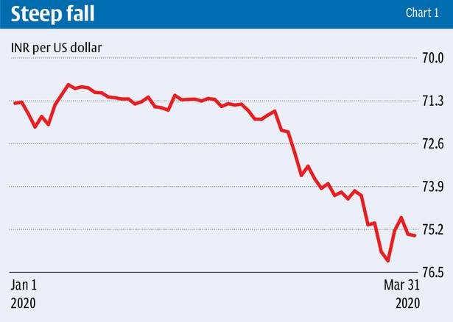
Impact of the lockdown on the Indian Economy at Macro Level
Inflation, that has been high before the spread of
Covid-19 (hitting a 7.6% high in January) is expected
to go down as oil prices dwindle ($23 bpd).
Rupee has been depreciating (record low of 76.55 against the dollar last week).
@italyinindia

Slide 9
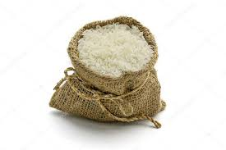
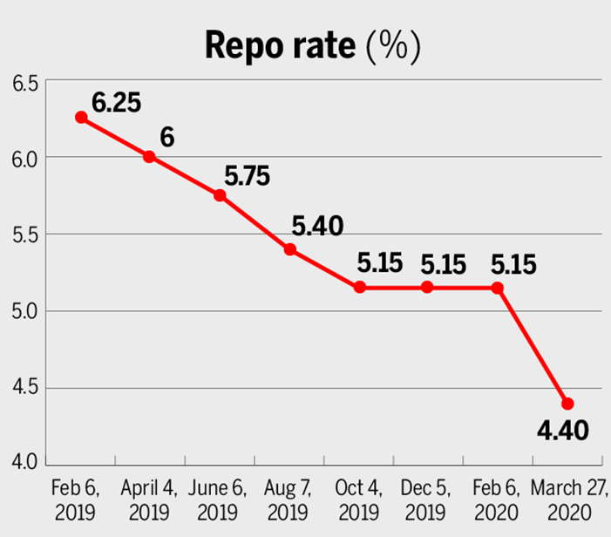
Fiscal and Monetary measures taken by GOI
India announced a $22.6 billion economic stimulus plan (=0,8% GDP) providing direct cash transfers and food security measures.
The RBI cut repo rate to 4.40%, the lowest in at least 15 years.
The reverse repo rate was cut by 90 bps to 4%, thus creating the so-called “asymmetrical corridor”.
@italyinindia

Slide 10
What we are working on…
Survey in cooperation with the IICC
Financial tools to support Italian investments in India. Role of SACE & SIMEST.
Economic and Commercial Task-force to support the companies in tackling critical issues stemming from the lockdown (also in coordination with the EU)
Resumption of international flights and subsequent resumption of visas services in cooperation with the Indian Embassy in Rome and MEA.
Organization of a series of webinars:
15th April, in cooperation with IICC, for Italian
Companies already established in India.
28th April, in cooperation with ITA, for Italian Companies
in Italy wishing to explore the Indian market.
More to come: with Sector-wise and State-wise
insights.
@italyinindia

Slide 11
PIANO STRAORDINARIO PER IL MADE IN ITALY
In the 2020 ITA budget, € 134 MLN are allocated for:
Communication
E-Commerce
The CuraItalia decree also
foresees additional funds
to strengthen the
ITA communication strategy.
@italyinindia

Slide 12
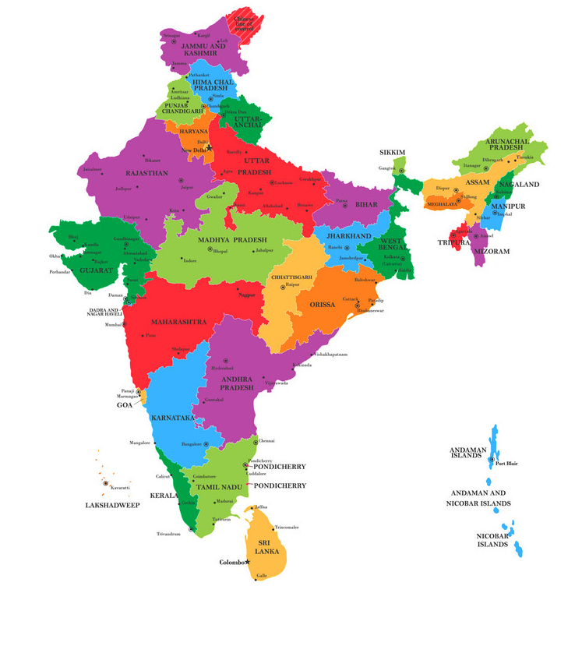
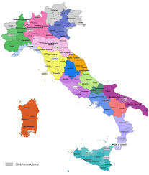
Insieme ce la faremo!
Together we shall overcome!
#StayingResilient
#MadeinItaly
#ItalyIndiaTogether
#DontStopThinkingAboutTheFuture
@italyinindia

